Slide 1

Windows Subsystem for Linux - Tutorial
Extended Topics:
WSL 2
VS Code

Slide 2
THIS PPT IS BEST VIEWED IN SLIDESHOW MODE

Slide 3
All links
Ubuntu [MS Store]- https://www.microsoft.com/store/productId/9NBLGGH4MSV6
WSL2 Kernel- https://wslstorestorage.blob.core.windows.net/wslblob/wsl_update_x64.msi
Windows Terminal [MS Store]- https://www.microsoft.com/store/productId/9N0DX20HK701
VSCode - https://go.microsoft.com/fwlink/?Linkid=852157
WSL extension-https://marketplace.visualstudio.com/items?itemName=ms-vscode-remote.remote-wsl
VcXsrv - https://sourceforge.net/projects/vcxsrv/

Slide 4
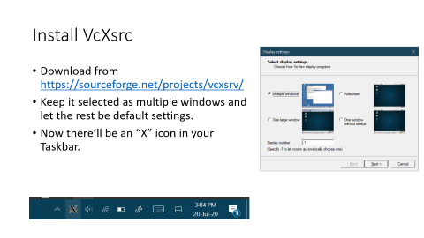
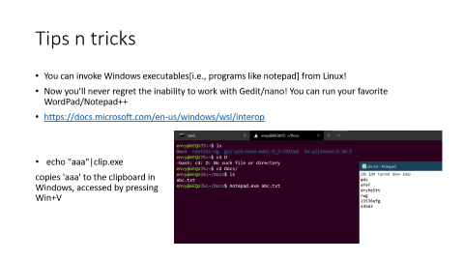
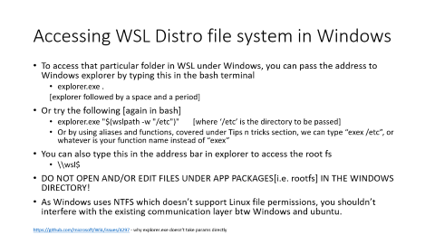
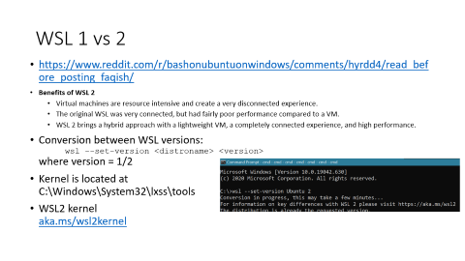
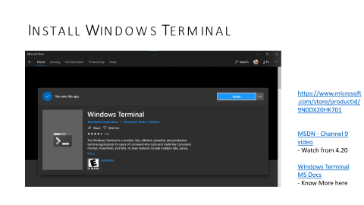
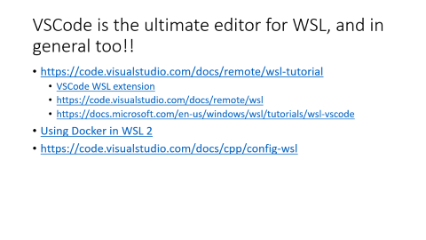
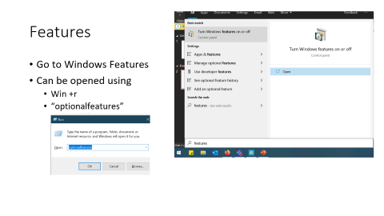


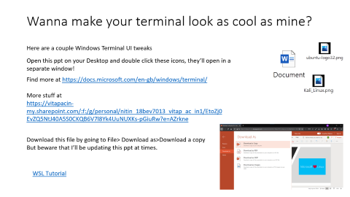

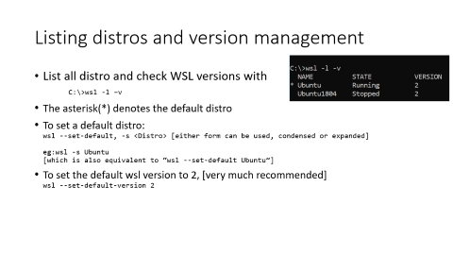


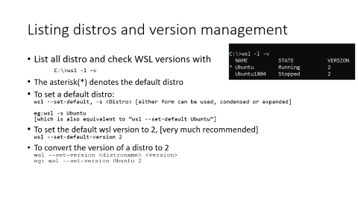

Installation:
Setting up Terminal
Aliases and more
Accessing files
VSCode
WSL Distro management
VcXsrc, in case you need to use non-terminal apps
Differences between WSL 1 and 2
Terminal Customization

Slide 5
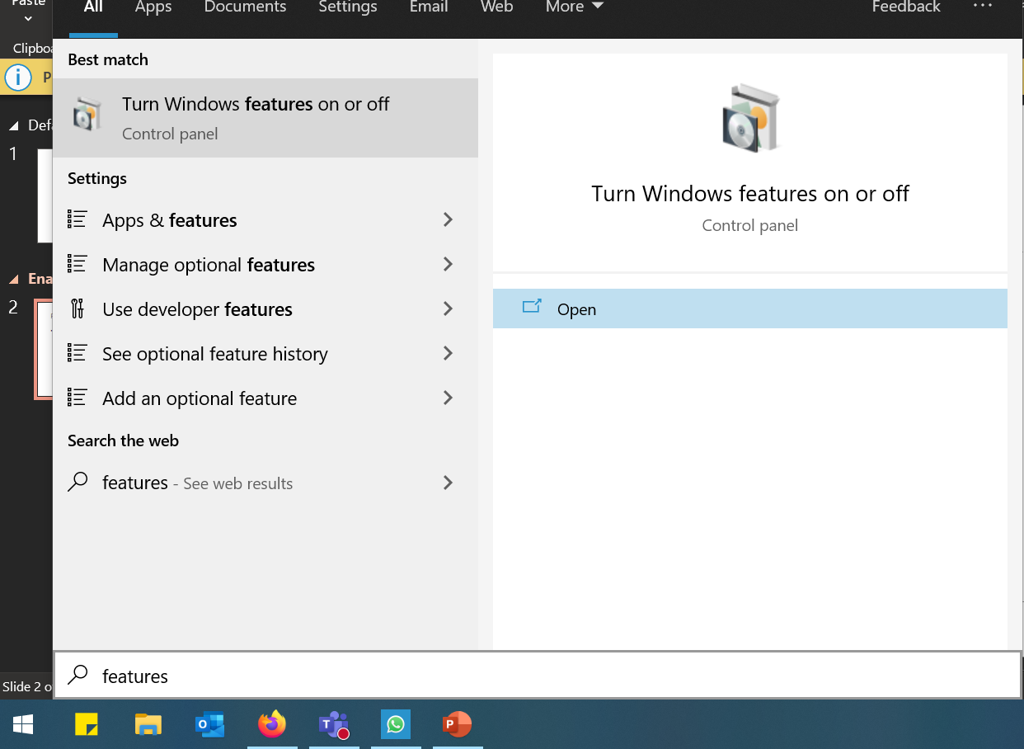
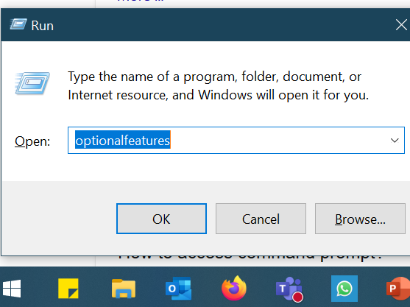
Features
Go to Windows Features
Can be opened using
Win +r
“optionalfeatures”

Slide 6
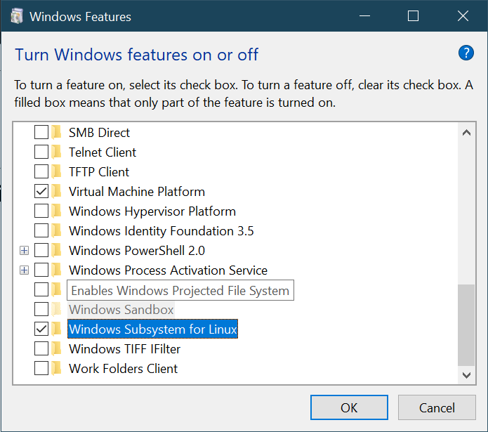








Enable WSL

Slide 7
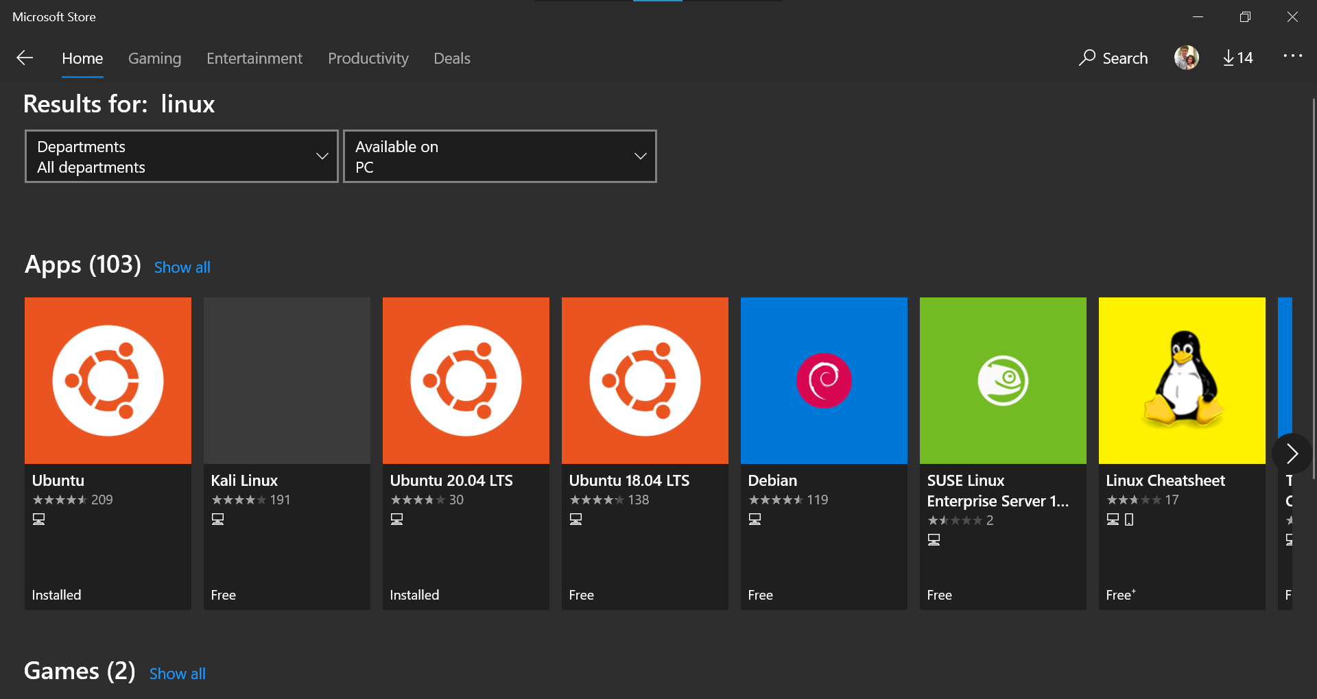
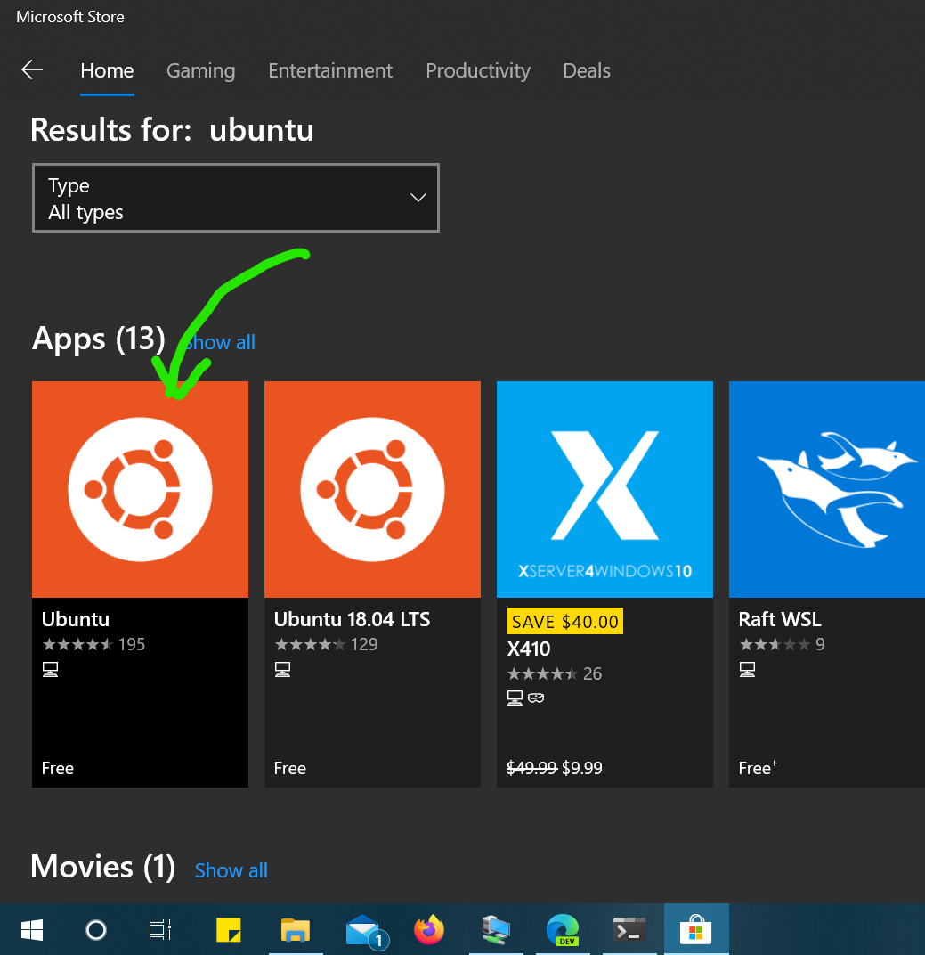
Install a Distro from Store
Search for Linux
Or Ubuntu
I recommend using Ubuntu, since the other distros I tried didn’t forward GUI apps properly
NOTE: You can also download .appx installers of these distros from https://docs.microsoft.com/en-us/windows/wsl/install-manual

Slide 8
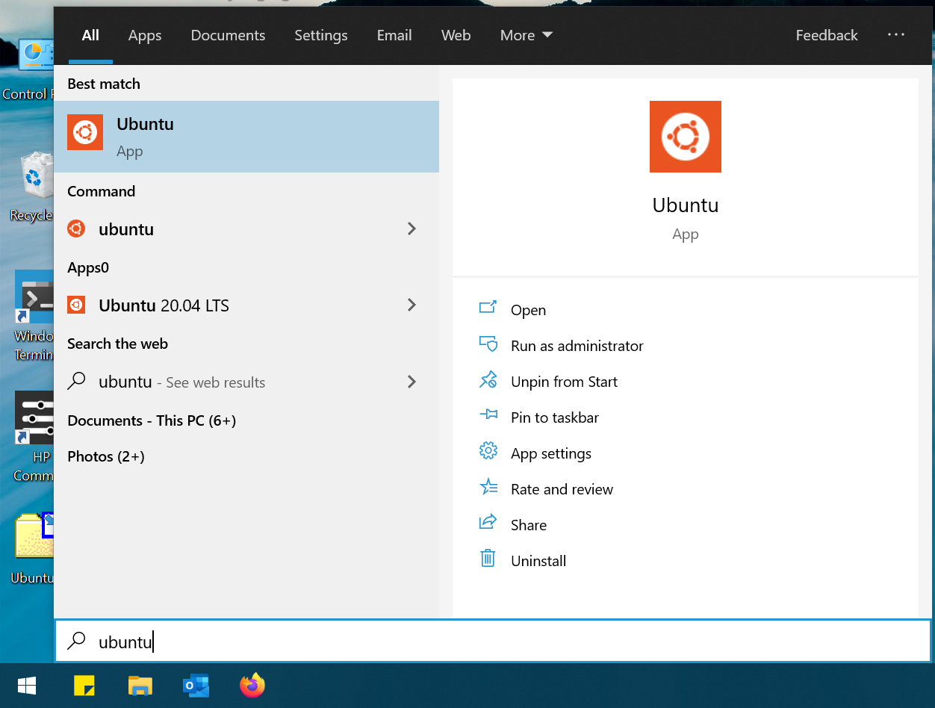
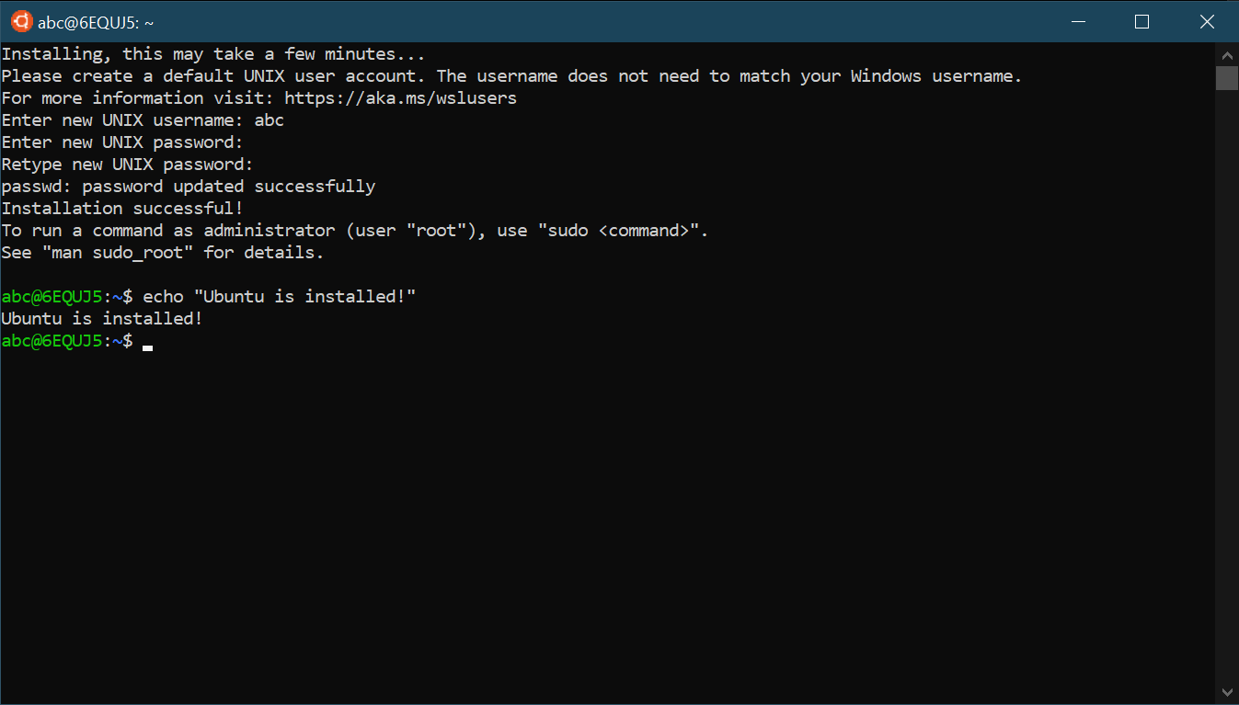
Setup your Ubuntu instance
For the first time, run Ubuntu from the Start Menu
Set up your UNIX username and password
Usernames should be lowercase
And the password when entered, isn’t displayed, yes, not even asterisks[*] come, no need to panic! 😅🙆‍♂️
And don’t forget to run every now and then
sudo apt update
sudo apt upgrade
apt-autoremove

Slide 9
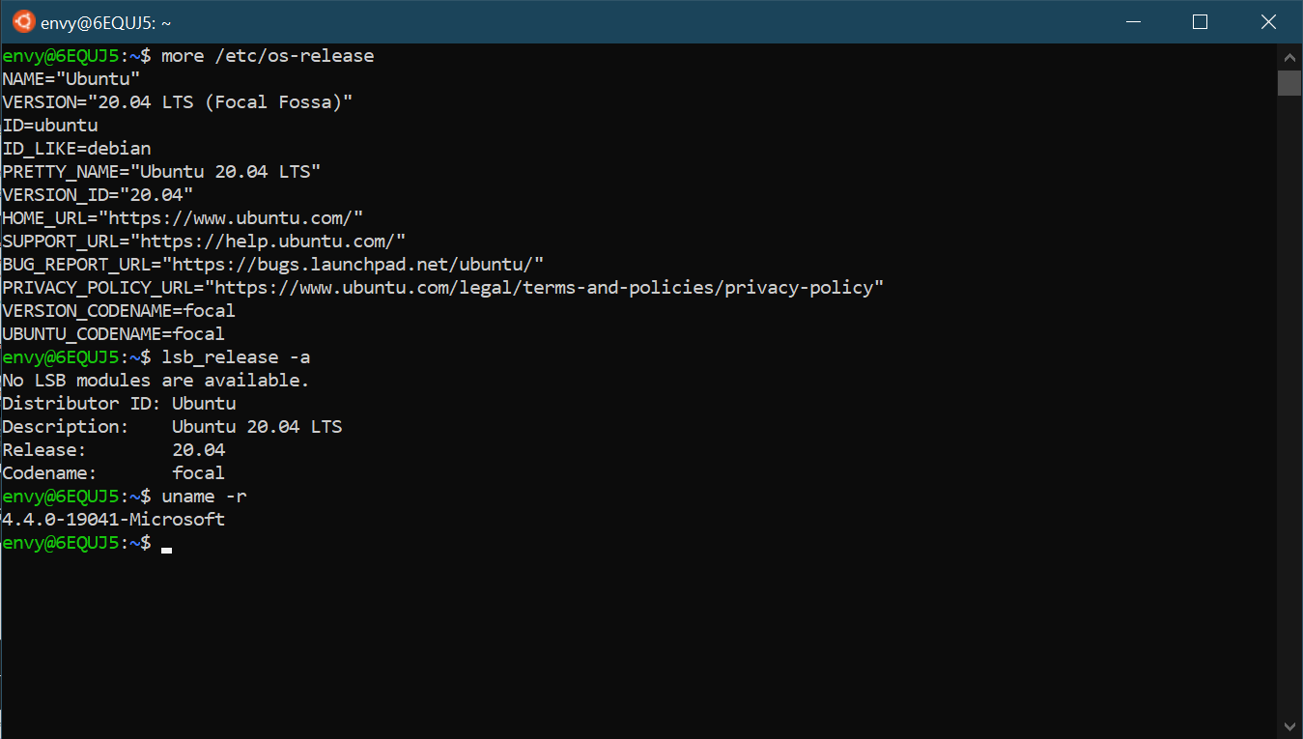
About the distro

Slide 10
For WSL 2
Check if Virtualization is enabled in the Task Manager.

Slide 11
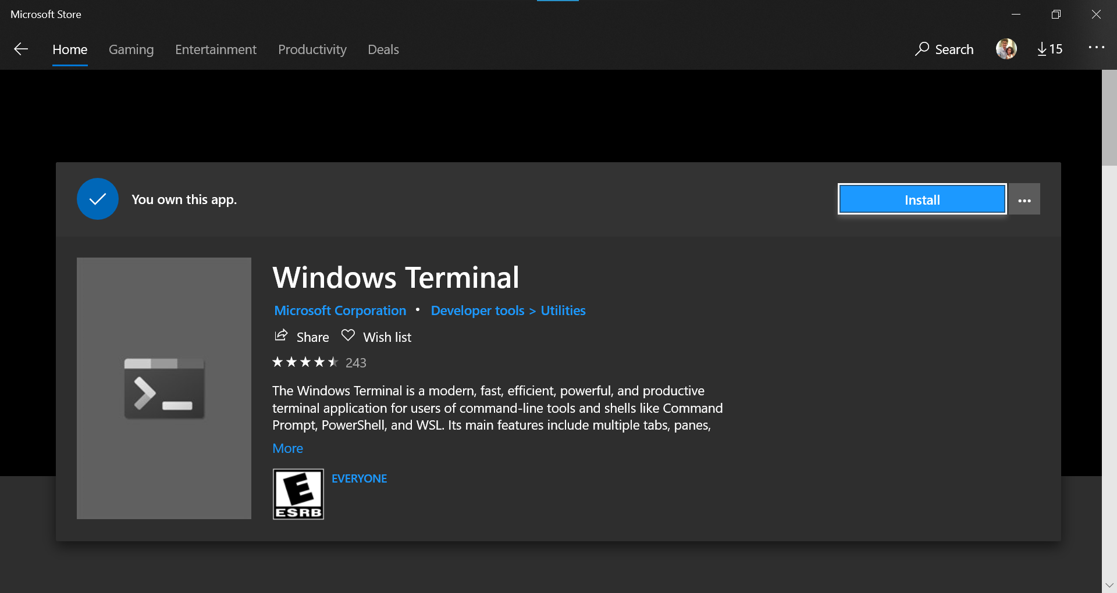
Install Windows Terminal
https://www.microsoft.com/store/productId/9N0DX20HK701
MSDN - Channel 9 video - Watch from 4.20 Windows Terminal MS Docs - Know More here

Slide 12
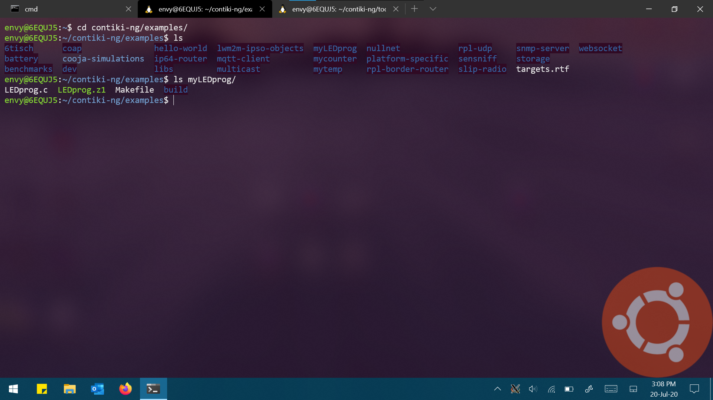


Windows Terminal Cont. Now you can run multiple tabs in a window

Slide 13
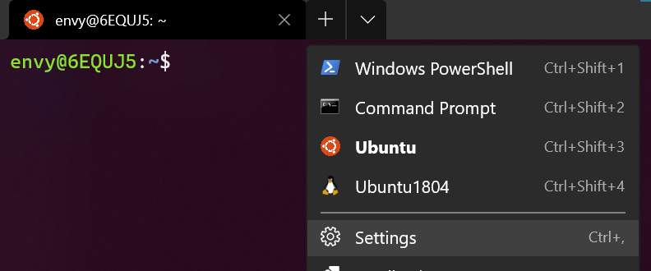
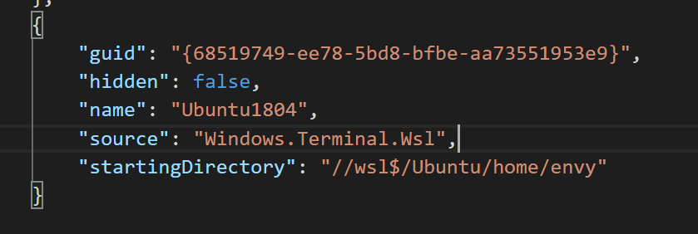

Changing distro settings
Changing the starting directory:
Open Terminal’s settings
either by gui
Or press ctrl+, [comma]
Scroll down to your distro’s name
And enter this line, or whatever directory you prefer.
Customization is covered in the last slides.
There are several other functions, but I won’t cover them, as they aren’t as important as this is. Get to know more here .
And for those users of WSL2, a kind note, performance will be much better when working inside linux directories, so instead of using your Desktop as the workspace, rather use your user directory in your distro.

Slide 14
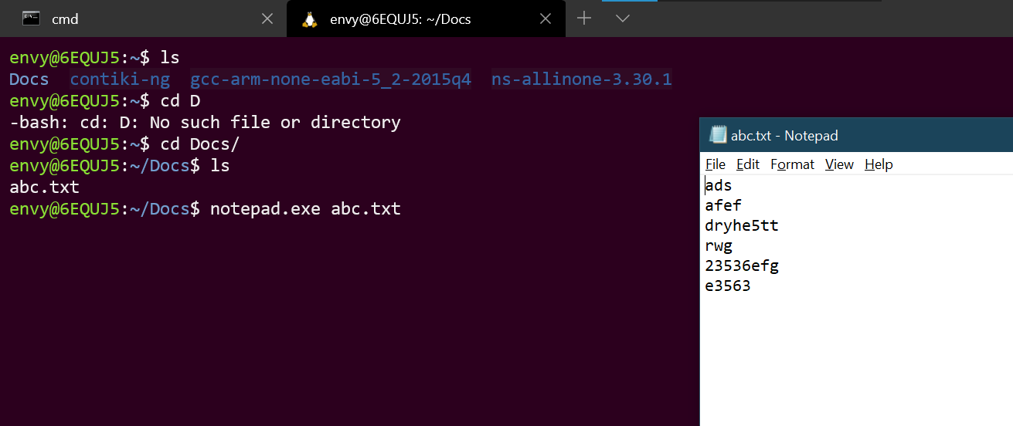
Tips n tricks
You can invoke Windows executables[i.e., programs like notepad] from Linux!
Now you’ll never regret the inability to work with Gedit/nano! You can run your favorite WordPad/Notepad++
https://docs.microsoft.com/en-us/windows/wsl/interop
echo "aaa"|clip.exe
copies 'aaa' to the clipboard in Windows, accessed by pressing Win+V

Slide 15
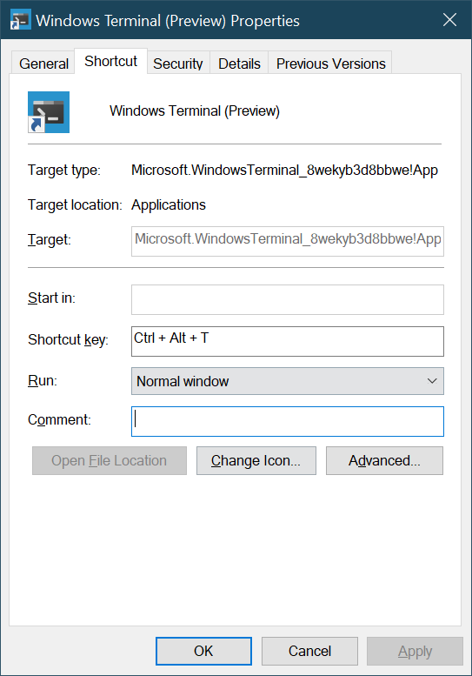



Launch Windows Terminal using ctrl+shift+t
Make a shortcut in Desktop (you can drag n drop from start menu)
Open the properties of that shortcut [right click>properties]
Set the Shortcut key
Voila!

Slide 16
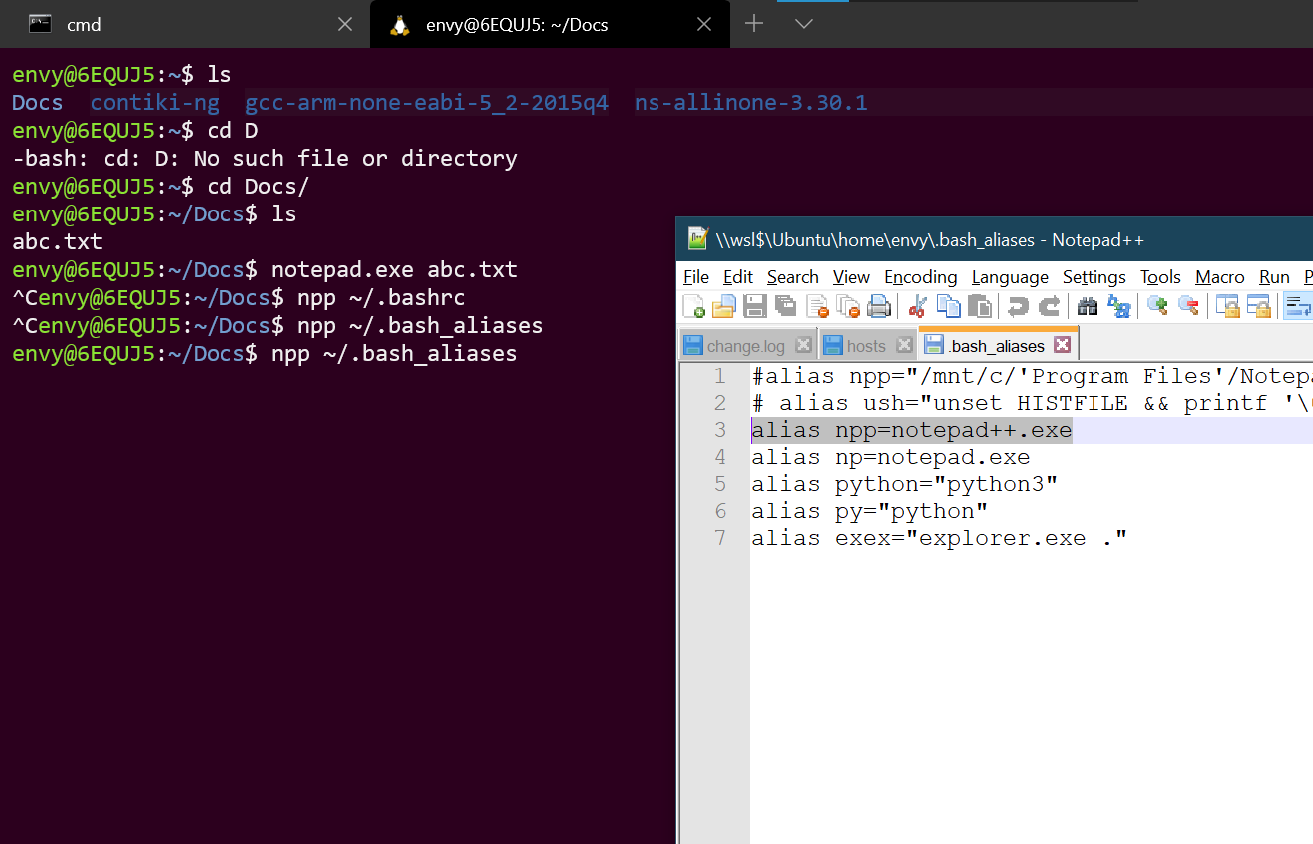
Aliases make the work easier
alias npp=notepad++.exe [you should add the directory to the path env variable]
[OR]
alias npp="/mnt/c/'Program Files'/Notepad++/notepad++.exe“ [without path env var]
Save these into ~/.bash_aliases

Slide 17
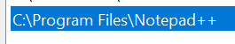
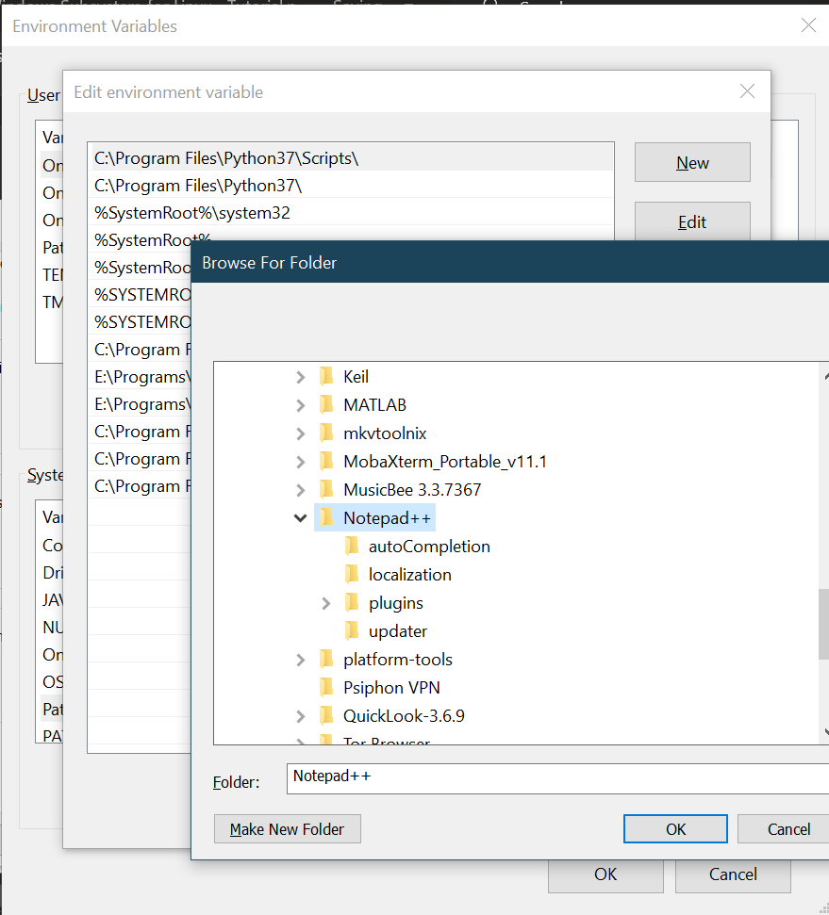
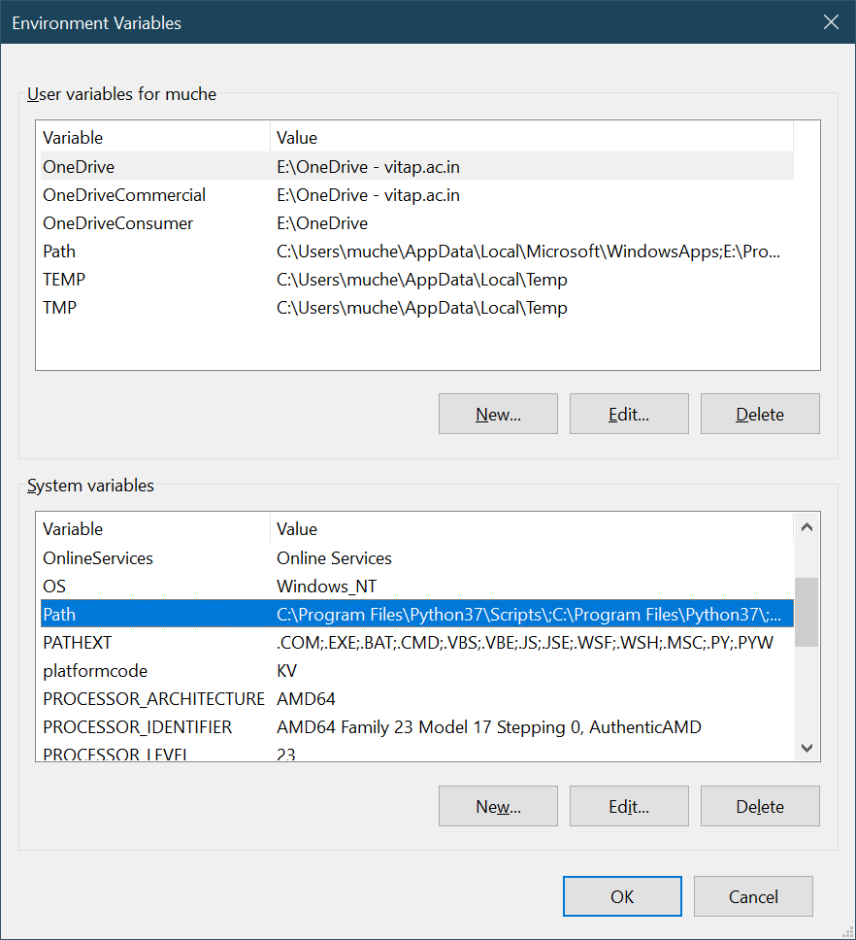
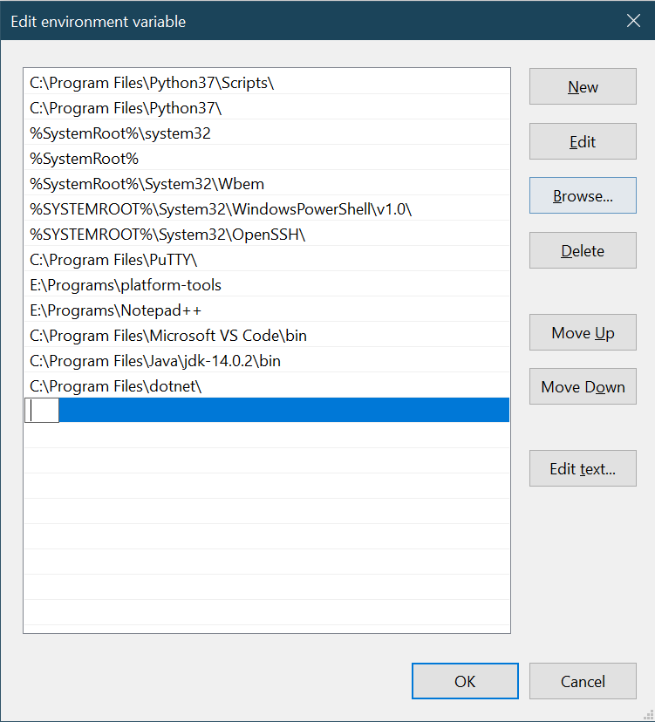




I use the Interop for Notepad++
alias npp=notepad++.exe
And the path to Notepad++.exe should already be added to the Path environment variable in Windows
win+r > systempropertiesadvanced > environment variables

Slide 18
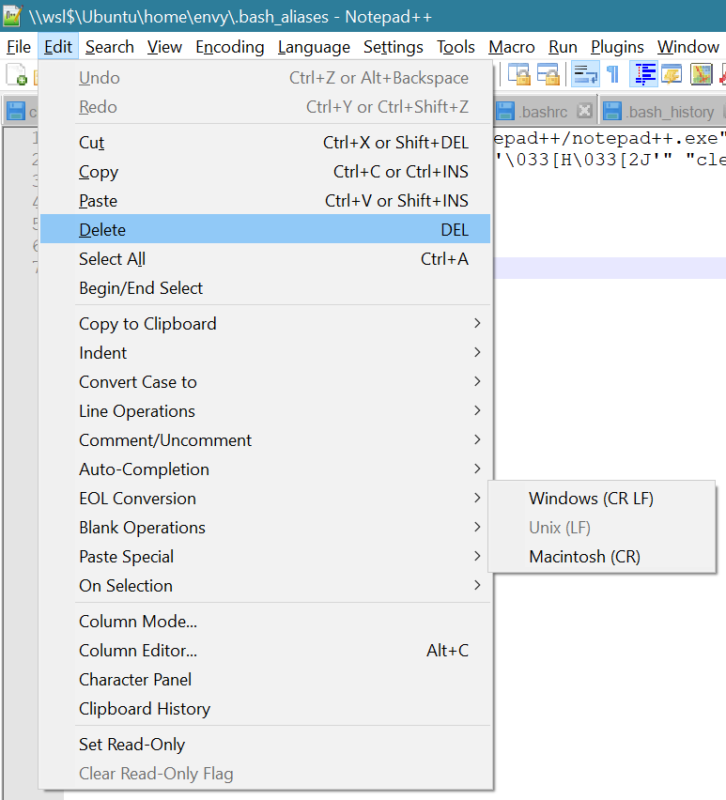

My .bash_aliases file
alias npp=notepad++.exe alias np=notepad.exe alias python="python3" alias py="python" wslcd(){ cd $(wslpath -u $1) } exex(){
if [[ $# -eq 0 ]] ;
then
explorer.exe "$(wslpath -w "$(pwd)")"
else
explorer.exe "$(wslpath -w "$1")"
fi
}
NOTE: If you’re using notepad++ to save this file, make sure to set EOL to “LF”
These two [wslcd, exex] are called functions, and work similarly to aliases, and can take arguments, unlike aliases.
wslcd is used instead of cd whenever using Windows paths, and exex for launching explorer in a specified linux directory.

Slide 19
Accessing WSL Distro file system in Windows
To access that particular folder in WSL under Windows, you can pass the address to Windows explorer by typing this in the bash terminal
explorer.exe .
[explorer followed by a space and a period]
Or try the following [again in bash]
explorer.exe "$(wslpath -w "/etc")" [where ‘/etc’ is the directory to be passed]
Or by using aliases and functions, covered under Tips n tricks section, we can type “exex /etc”, or whatever is your function name instead of “exex”
You can also type this in the address bar in explorer to access the root fs
\\wsl$
DO NOT OPEN AND/OR EDIT FILES UNDER APP PACKAGES[i.e. rootfs] IN THE WINDOWS DIRECTORY!
As Windows uses NTFS which doesn’t support Linux file permissions, you shouldn’t interfere with the existing communication layer btw Windows and ubuntu.
https://github.com/microsoft/WSL/issues/4297 - why explorer.exe doesn’t take params directly

Slide 20
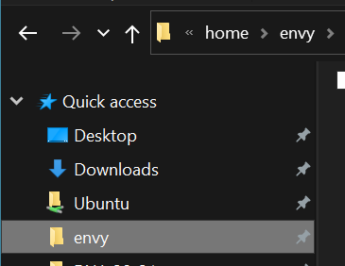
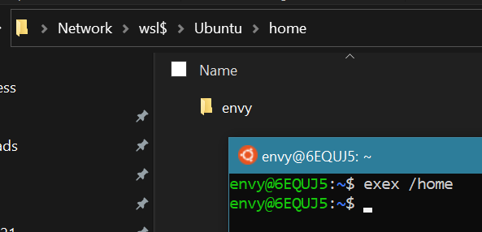
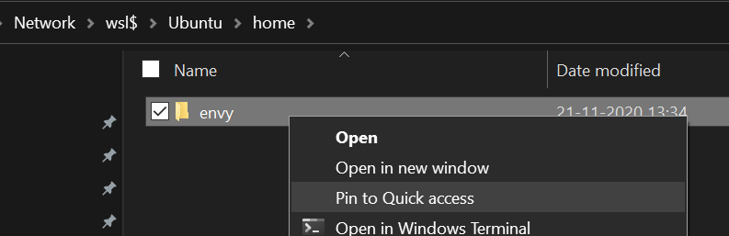
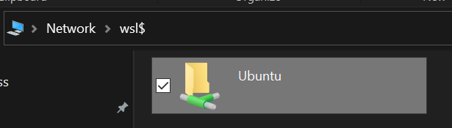
Adding the Ubuntu directory to quick access
Step 1: in bash, if you have set up my aliases, type in ~$ exex /home
Step 2: In case you aren’t using aliases,
type in “cd /home” in bash, and then “explorer.exe .”, then continue to step 3
Step 4: Right click on your username[“envy” in my case] and pin it to quick access.
Next time, when you open “This PC”, you can go straight to your linux directory.
You can also pin the rootfs of the distro [“Ubuntu” in my case], from the location “\\wsl$”

Slide 21
VSCode is the ultimate editor for WSL, and in general too!!
https://code.visualstudio.com/docs/remote/wsl-tutorial
VSCode WSL extension
https://code.visualstudio.com/docs/remote/wsl
https://docs.microsoft.com/en-us/windows/wsl/tutorials/wsl-vscode
Using Docker in WSL 2
https://code.visualstudio.com/docs/cpp/config-wsl

Slide 22
You can make copies of distros and much more!
Usage: wsl.exe [Argument] [Options...] [CommandLine] Arguments for running Linux binaries: If no command line is provided, wsl.exe launches the default shell. --exec, -e <CommandLine> Execute the specified command without using the default Linux shell. -- Pass the remaining command line as is. Options: --distribution, -d <Distro> Run the specified distribution. --user, -u <UserName> Run as the specified user. Arguments for managing Windows Subsystem for Linux: --export <Distro> <FileName> Exports the distribution to a tar file. The filename can be - for standard output. --import <Distro> <InstallLocation> <FileName> [Options] Imports the specified tar file as a new distribution. The filename can be - for standard input. Options: --version <Version> Specifies the version to use for the new distribution. --list, -l [Options] Lists distributions. Options: --all List all distributions, including distributions that are currently being installed or uninstalled. --running List only distributions that are currently running. --quiet, -q Only show distribution names. --verbose, -v Show detailed information about all distributions. --set-default, -s <Distro> Sets the distribution as the default. --set-default-version <Version> Changes the default install version for new distributions. --set-version <Distro> <Version> Changes the version of the specified distribution. --shutdown Immediately terminates all running distributions and the WSL 2 lightweight utility virtual machine. --terminate, -t <Distro> Terminates the specified distribution. --unregister <Distro> Unregisters the distribution. --help Display usage information.
NOTE: ALL WSL MANAGEMENT CMDS GO TO CMD PROMPT, NOT BASH SHELL.

Slide 23
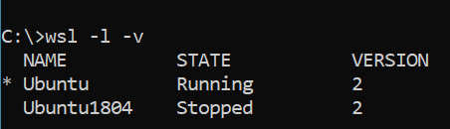
Listing distros and version management
List all distro and check WSL versions with C:\>wsl -l –v
The asterisk(*) denotes the default distro
To set a default distro: wsl --set-default, -s <Distro> [either form can be used, condensed or expanded] eg:wsl -s Ubuntu [which is also equivalent to “wsl --set-default Ubuntu”]
To set the default wsl version to 2, [very much recommended] wsl --set-default-version 2
To convert the version of a distro to 2 wsl --set-version <distroname> <version> eg: wsl --set-version Ubuntu 2

Slide 24
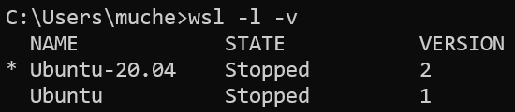
Making a copy [i.e., exporting and importing]
1. All the distros
2. Export to a file
wsl --export Ubuntu-20.04 E:\Desktop\ubuntu_v2.tar
3. Import to a destination folder
wsl –import Ubuntuv2 E:\Programs\UbuntuOnWSL2 E:\Desktop\ubuntu_v2.tar

Slide 25
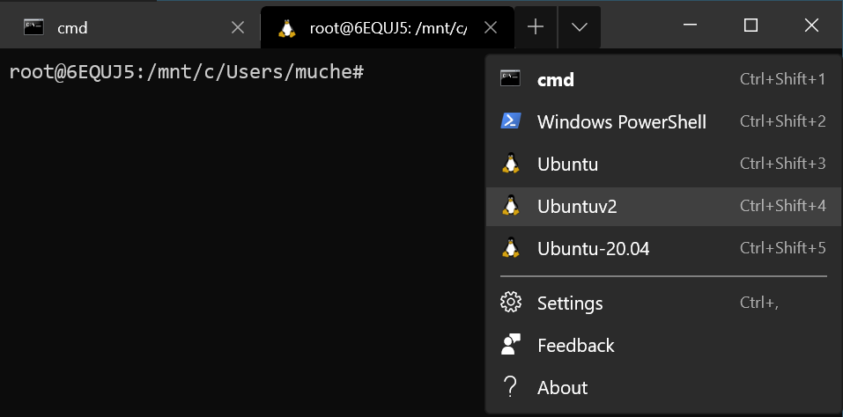
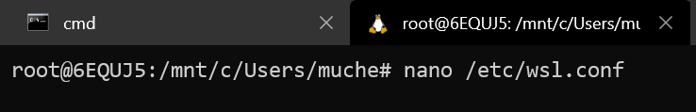
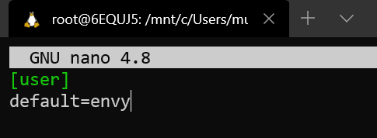
Problems faced when you import a distro
https://github.com/Microsoft/WSL/issues/3974#issuecomment-576782860
https://docs.microsoft.com/en-us/windows/wsl/wsl-config#configure-per-distro-launch-settings-with-wslconf
The user on launch of a terminal isn’t the previous default [from the exported distro]
You’ll have to set a wsl.conf under /etc/ as a root use with the following content:
[user]
default=[username]

Slide 26
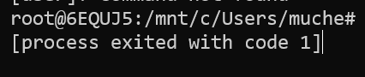
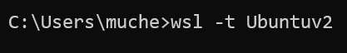
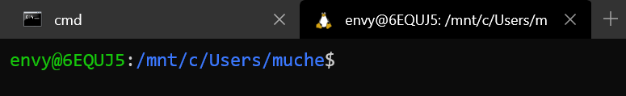
Cont.
Force shutdown the imported distro [restart is necessary to enforce wsl.conf] using wsl –t [distro name]
The next time you launch that distro, it’ll have the default user.

Slide 27
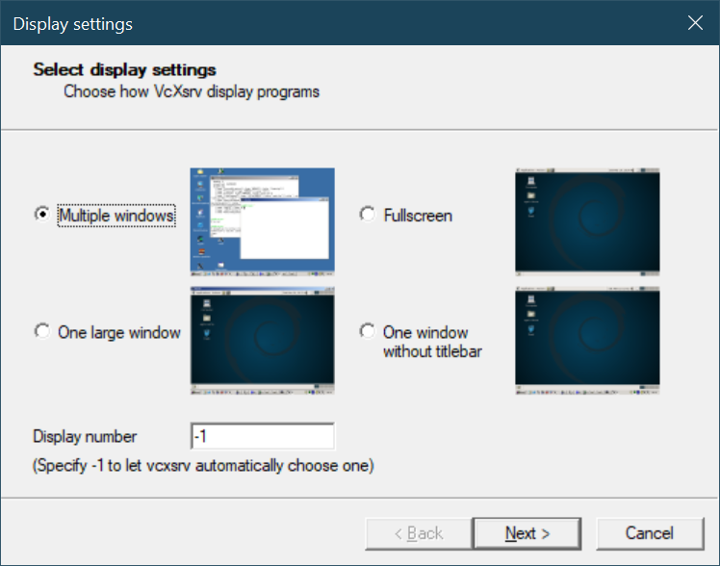


Install VcXsrc
Download from https://sourceforge.net/projects/vcxsrv/
Keep it selected as multiple windows and let the rest be default settings.
Now there’ll be an “X” icon in your Taskbar.

Slide 28
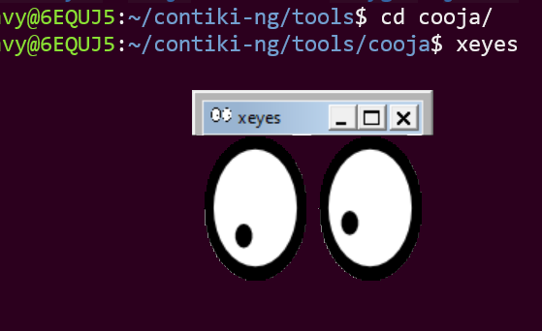
Export DISPLAY [WSL 1 only]
Run “export DISPLAY=localhost:0.0”
For doing it everytime, save it to ~/.bashrc
echo 'export DISPLAY=localhost:0.0' >> ~/.bashrc
Then you can run GUI apps as seen in the next slide
A simple test is to run xeyes
Quick tip: Check your WSL version by wsl –l -v

Slide 29
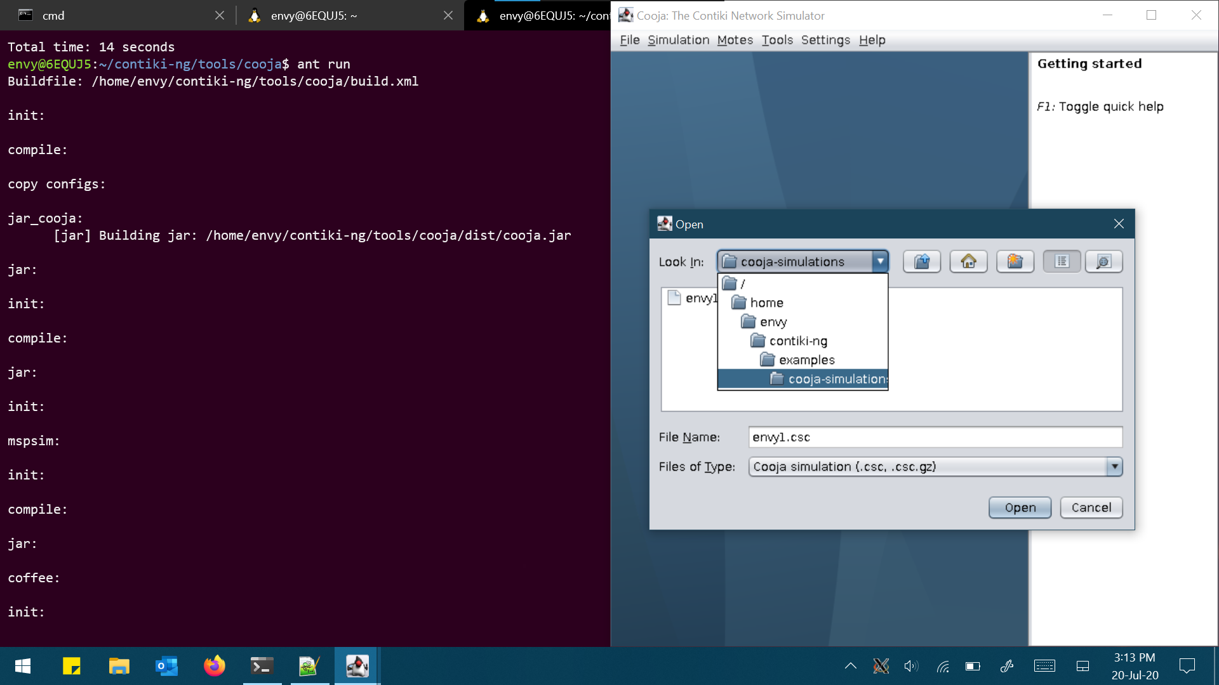
Here you can see the Cooja Network Simulator running

Slide 30
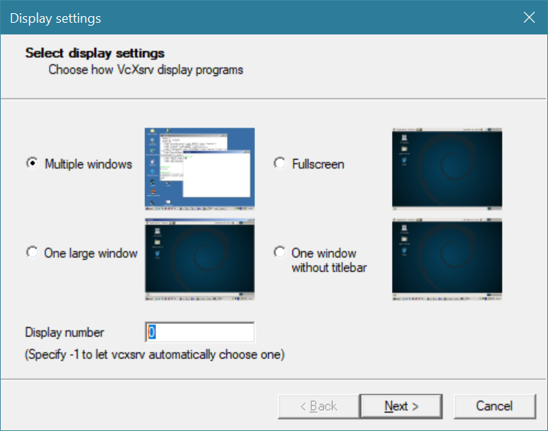
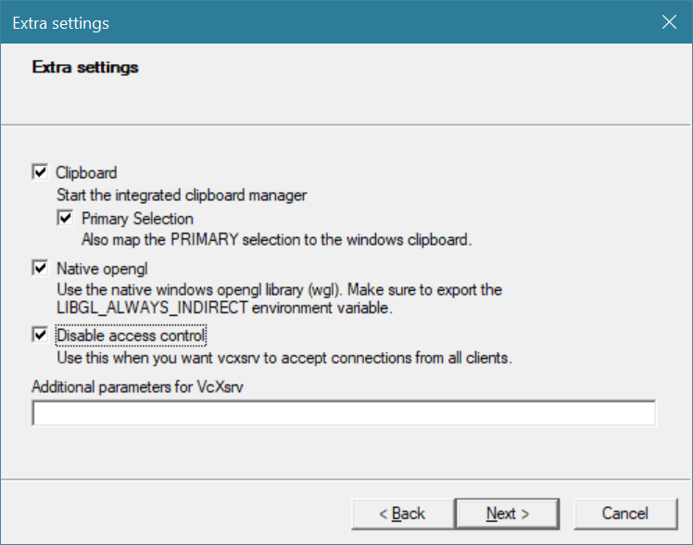
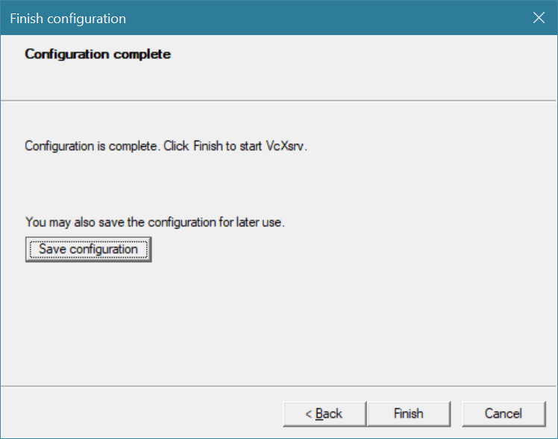
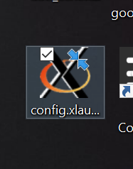



For WSL2
export DISPLAY=$(cat /etc/resolv.conf | grep nameserver | awk '{print $2; exit;}’):0
export DISPLAY=$(awk '/nameserver / {print $2; exit}' /etc/resolv.conf 2>/dev/null):0
VcXsrv:

Slide 31
A-I-O Alternative
You can use an application called MobaXterm
It automatically detects WSL instances and configures displays as it has its own X-server.
https://mobaxterm.mobatek.net/download.html

Slide 32
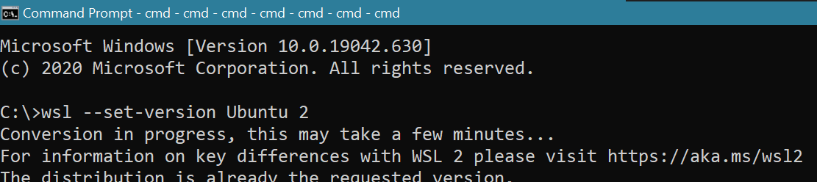
WSL 1 vs 2
https://www.reddit.com/r/bashonubuntuonwindows/comments/hyrdd4/read_before_posting_faqish/
Benefits of WSL 2
Virtual machines are resource intensive and create a very disconnected experience.
The original WSL was very connected, but had fairly poor performance compared to a VM.
WSL 2 brings a hybrid approach with a lightweight VM, a completely connected experience, and high performance.
Conversion between WSL versions: wsl --set-version <distroname> <version> where version = 1/2
Kernel is located at C:\Windows\System32\lxss\tools
WSL2 kernel aka.ms/wsl2kernel

Slide 33




Wanna make your terminal look as cool as mine?
Here are a couple Windows Terminal UI tweaks
Open this ppt on your Desktop and double click these icons, they’ll open in a separate window!
Find more at https://docs.microsoft.com/en-gb/windows/terminal/
More stuff at https://vitapacin-my.sharepoint.com/:f:/g/personal/nitin_18bev7013_vitap_ac_in1/EtoZj0EvZQ5NtJ40A5S0CKQB6V7l8Yk4UuNUXKs-pGiuRw?e=AZrkne
Download this file by going to File> Download as>Download a copy
But beware that I’ll be updating this ppt at times.
WSL Tutorial

Slide 34

SPREAD THE LOVE!

